Slide 1
Database System
Lecturer: 冯凤娟
E-mail: fjfeng@bjtu.edu.cn
Office: YF811
Office hour : Monday 16:00-17:00
Thursday 14:00-17:00

Slide 2
Course text
（1）English text book- ---《 A First Course in DATABASE SYSTEMS 》 （Third Edition）
中文名称：《数据库系统基础教程》
Jeffrey D.Ullman 、Jennifer Widom
机械工业出版社 斯坦福大学 2008.8
（2）references book----国家级十一五规划教材
《数据库技术与应用》
北京交通大学出版社 冯凤娟 2011.4

Slide 3
Grades
Attendence and Answer Question (10%)
Homework Exercises (10%)
Individual Laboratory projects（20%）
Group Laboratory projects（10%）
Final exam（50%）

Slide 4

作业 (Homework Assignments)
每章结束后一周之内交；
within 1 weeks after a chapter is finished
迟交罚扣 (late penalty) 为2 pts/Chap；
做则有分，不计对错。
you can gain scores only if handing in whether right or not.
一周后公布参考答案。

Slide 5
Topics
Chapter1：introduction database
Chapter 2：architecture DBMS
Chapter 3：data model concept
Chapter 4：relational algebra
Chapter 5：SQL introduction and DDL_and_constraint
Chapter 6： storage procedure and trigger，JDBC
Chapter 7： database design
Chapter 8： ER-model and Enhanced--ER--model
Chapter 9： normalization
Chapter 10：authorization
Chapter 11：transaction--management

Slide 6
Chapter 1
Introduction to Databases
Transparencies

Slide 7
Chapter 1 - Objectives
Some common uses of database systems.
Characteristics of file-based systems.
Problems with file-based approach.
Meaning of the term database.
Meaning of the term Database Management System (DBMS).

Slide 8
Chapter 1 - Objectives
Typical functions of a DBMS.
Major components of the DBMS environment.
Personnel involved in the DBMS environment.
History of the development of DBMSs.
Advantages and disadvantages of DBMSs.

Slide 9
Examples of Database Applications
Purchases from the supermarket
Purchases using your credit card
Booking a holiday at the travel agents
Using the local library
Taking out insurance
Using the Internet
Studying at university

Slide 10
File-Based Systems
Collection of application programs that perform services for the end users (e.g. reports).
Each program defines and manages its own data.

Slide 11
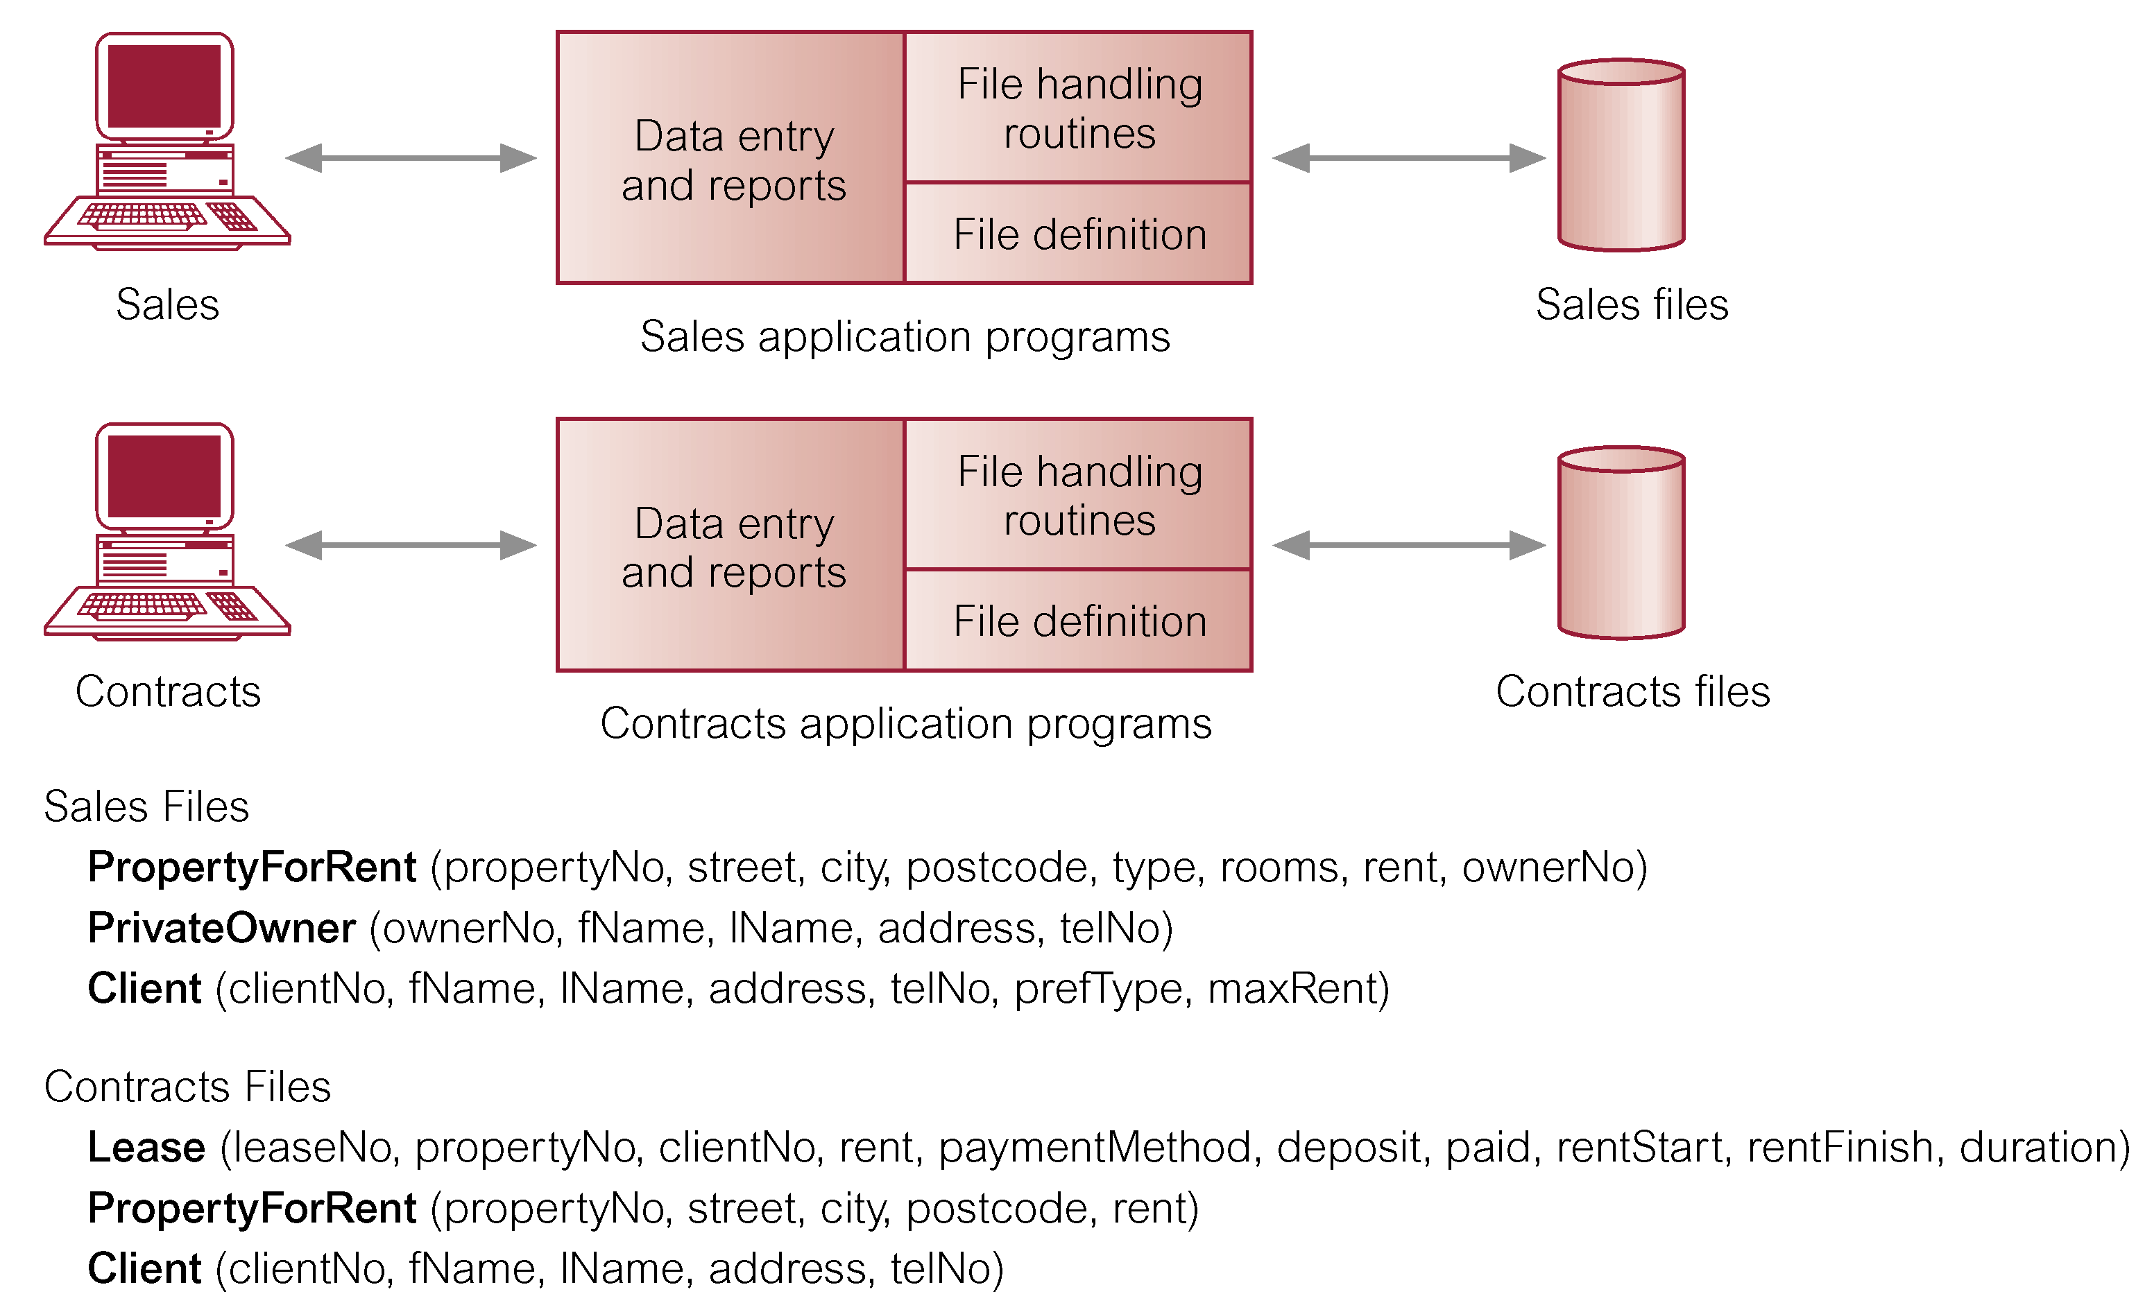
File-Based Processing

Slide 12
Limitations of File-Based Approach
Separation and isolation of data
  Each program maintains its own set of data.
  Users of one program may be unaware of potentially useful data held by other programs.
Duplication of data
  Same data is held by different programs.
  Wasted space and potentially different values and/or different formats for the same item.

Slide 13
Limitations of File-Based Approach
Data dependence
  File structure is defined in the program code.
Incompatible file formats
  Programs are written in different languages, and so cannot easily access each other’s files.
Fixed Queries/Proliferation of application programs
  Programs are written to satisfy particular functions.
  Any new requirement needs a new program.

Slide 14
Database Approach
Arose because:
  Definition of data was embedded in application programs, rather than being stored separately and independently.
  No control over access and manipulation of data beyond that imposed by application programs.
Result:
  the database and Database Management System (DBMS).

Slide 15
Database
Shared collection of logically related data (and a description of this data), designed to meet the information needs of an organization.
System catalog (metadata) provides description of data to enable program–data independence.
Logically related data comprises entities, attributes, and relationships of an organization’s information.

Slide 16
Database Management System (DBMS)
A software system that enables users to define, create, and maintain the database and that provides controlled access to this database.

Slide 17
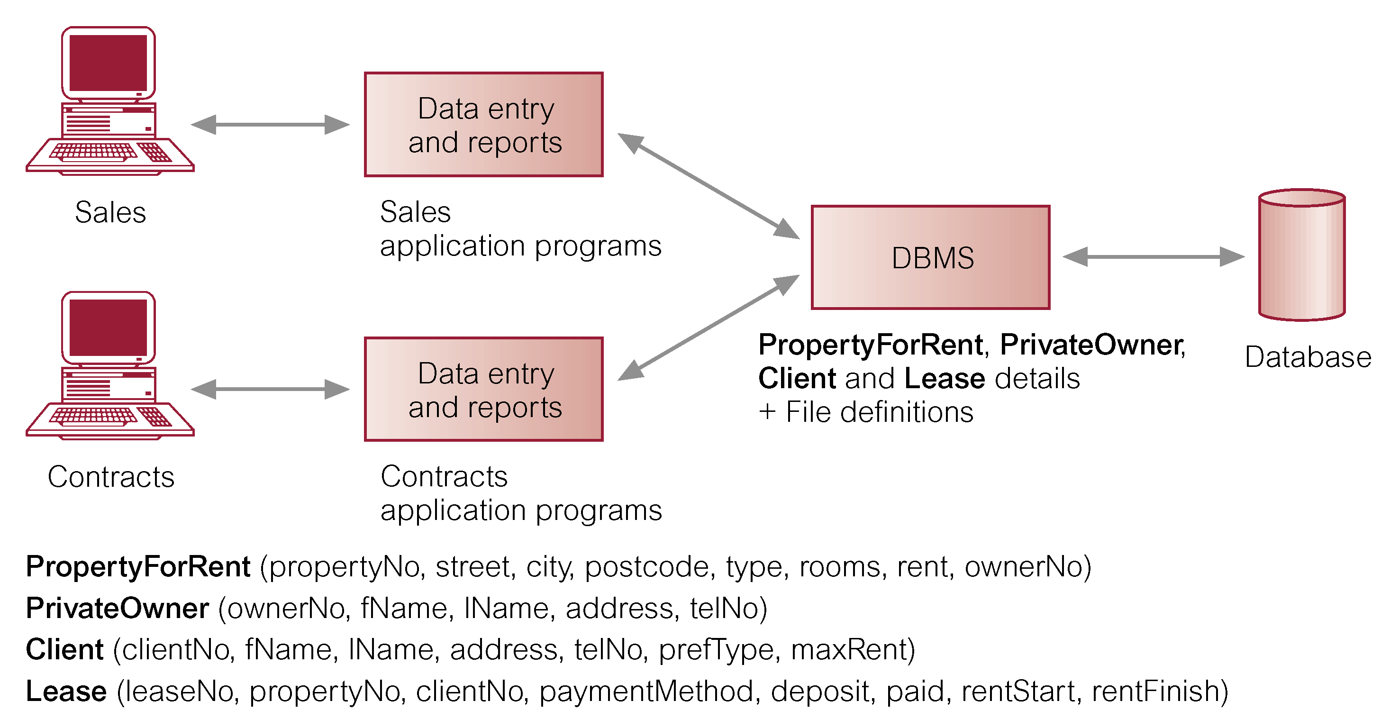
Database Management System (DBMS)

Slide 18
Database Approach
Data definition language (DDL).
  Permits specification of data types, structures and any data constraints.
  All specifications are stored in the database.
Data manipulation language (DML).
  General enquiry facility (query language) of the data.
  Data control language (DCL)

Slide 19
Database Approach
Controlled access to database may include:
  A security system.
  An integrity system.
  A concurrency control system.
  A recovery control system.
  A user-accessible catalog.
A view mechanism.
  Provides users with only the data they want or need to use.

Slide 20
Views
Allows each user to have his or her own view of the database.
A view is essentially some subset of the database.

Slide 21
Views
Benefits include:
  Reduce complexity;
  Provide a level of security;
  Provide a mechanism to customize the appearance of the database;
  Present a consistent, unchanging picture of the structure of the database, even if the underlying database is changed.

Slide 22
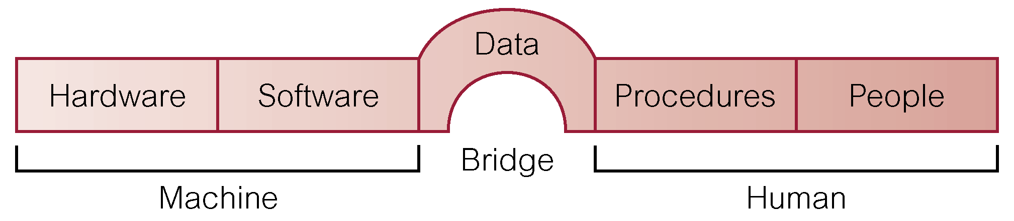
Components of DBMS Environment

Slide 23
Components of DBMS Environment
Hardware
  Can range from a PC to a network of computers.
Software
  DBMS, operating system, network software (if necessary) and also the application programs.
Data
  Used by the organization and a description of this data called the schema.

Slide 24
Components of DBMS Environment
Procedures
  Instructions and rules that should be applied to the design and use of the database and DBMS.
People

Slide 25
Roles in the Database Environment
◆ Data Administrator (DA)
◆ Database Administrator (DBA)
◆ Database Designers (Logical and Physical)
◆ Application Programmers
◆ End Users (naive and sophisticated)

Slide 26
History of Database Systems
First-generation
  Hierarchical and Network
Second generation
  Relational
Third generation
  Object Relational
  Object-Oriented

Slide 27
Advantages of DBMSs
◆Control of data redundancy
◆ Data consistency
◆ More information from the same amount of data
◆ Sharing of data
◆ Improved data integrity
◆ Improved security
◆ Enforcement of standards
◆ Economy of scale

Slide 28
Advantages of DBMSs
◆ Balanced conflicting requirements
◆ Improved data accessibility and responsiveness
◆ Increased productivity
◆ Improved maintenance through data independence
◆ Increased concurrency
◆ Improved backup and recovery services

Slide 29
Disadvantages of DBMSs
◆ Complexity
◆ Size
◆ Cost of DBMS
◆ Additional hardware costs
◆ Cost of conversion
◆ Performance
◆ Higher impact of a failure

